Slide 1
Deck Editing: Changing colors and fonts
This presentation was created by the Advancing Conservation through Empathy for Wildlife (ACE for Wildlife®) Network. These slides are designed to be customized, if you would like to change branding to match your home organization. All text, colors, images, logos, and design elements can be edited directly within each slide.
Change colors
  Select the shape or design element you want to update.
  Go to Shape Format > Shape Fill.
  Select your brand color or choose More Fill Colors to enter a specific RGB or HEX value.
Change fonts
  Select the text you want to update.
  Go to Home > Font.
  Choose your organization’s brand font, size, and color.
Edit text
  Click inside any text box and type or paste your new copy.

Slide 2
Deck Editing: Replace Logos & Images
Replace a logo
  Select the existing logo (at the bottom of each slide)
  Go to Picture Format > Change Picture > From a File.
  Select your organization’s logo.
Using Change Picture instead of deleting the existing image will help preserve its size and placement.
Replace a photo
  Select the photo you want to replace.
  Go to Picture Format > Change Picture > From a File.
  Choose your new image.
  Use Picture Format > Crop to adjust how the image fits within the existing space.
Move or resize an element
  Click an object to select it, then drag it to reposition it. Use the corner handles to resize while maintaining its proportions.

Slide 3
Deck Editing: Note about slide 14
Slide 14 includes a custom animated video that was created specifically for this presentation. Unlike the other slides in this deck, the individual elements within the video cannot be edited directly in PowerPoint.
When customizing this presentation:
The existing video can be kept as is if it works for your presentation.
If you need different branding or content, replace Slide 14 with your own static slide or other content.
The video is not intended to be rebranded or recreated as part of this template.
All other slides can be customized using the editing instructions in this guide.

Slide 4
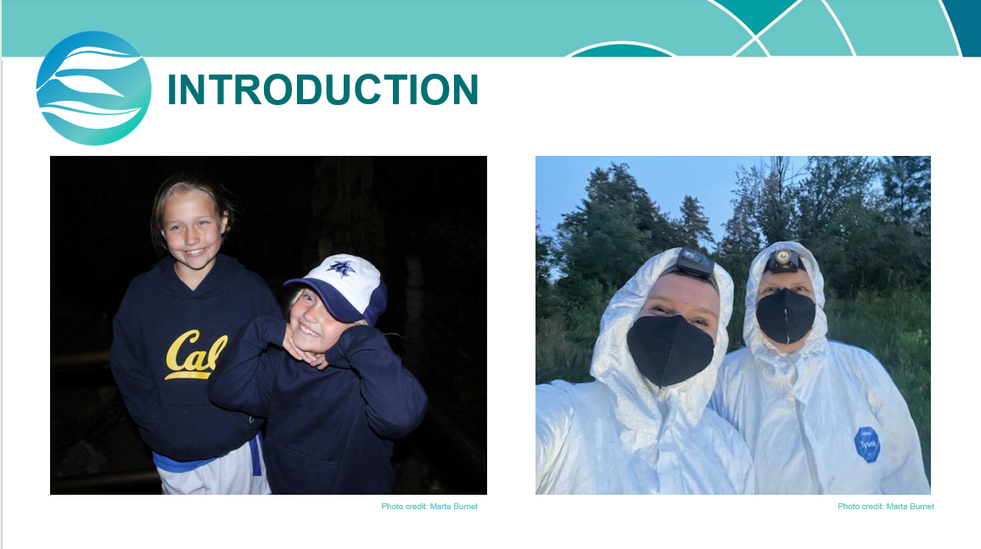
Recommended Addition: Personal story slide
As you prepare to present and discuss empathy for wildlife work with your organization’s leader(s), we recommend developing a personal story to incorporate as part of your presentation introduction.
Telling personal stories about empathy for wildlife work – how it has impacted us, or how we personally have seen it impact others – can make our message about the benefits of this work more memorable and accessible.
You may want to consider creating a new slide in this deck to support your storytelling. A new slide should include a relevant photo and minimal text on screen (see example screenshot below) to accompany your personal story.
Photo credit: Marta Burnet.

Slide 5

What is fostering empathy for wildlife?

Slide 6
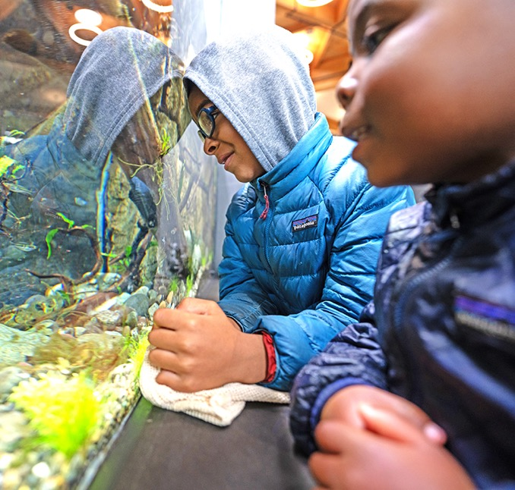

Zoos and aquariums welcome millions of guests every year.
We connect guests with the animals they encounter in ways that are unique and meaningful.

Slide 7
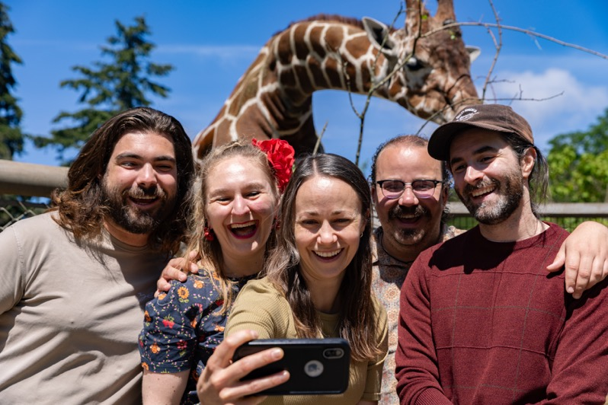
How are we helping guests move towards conservation action in their own lives?

Slide 8
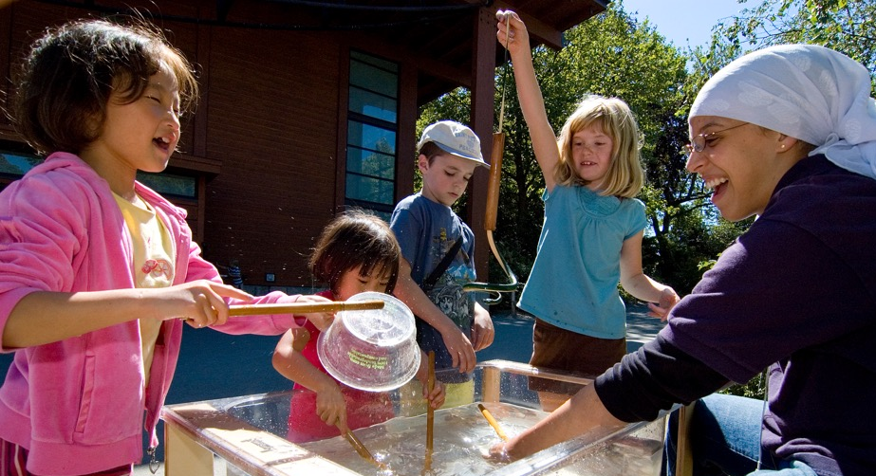
We have an opportunity to go further.
Transform guest perceptions of our organizations away from entertainment and towards conservation.
Support animal wellbeing by bringing guests closer to the purpose behind our work.
Forge a new relationship with our audiences and motivate their loyalty.

Slide 9
How can we inspire positive action for wildlife?
It starts with fostering empathy.
Empathy is an emotional state that relies on the ability to engage in one or more of the following: perception, understanding, feeling, and/or action in response to the experiences or perspectives of another living being.
Whitley et al., 2026

Slide 10
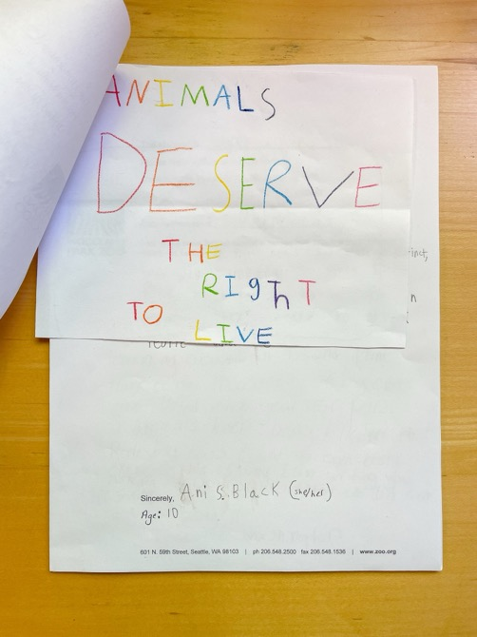
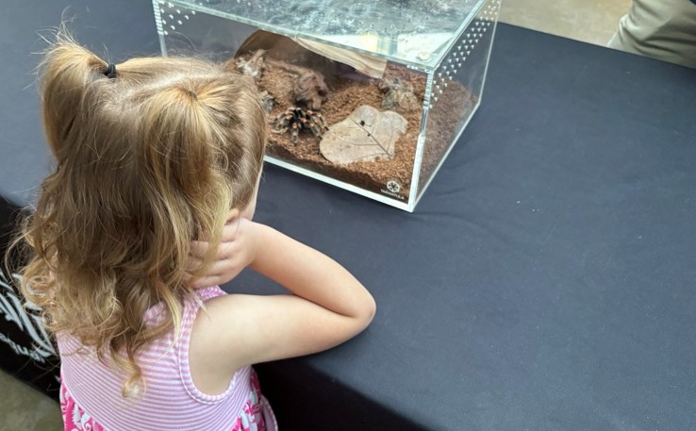
Motivational Empathy
Caring and Conservation Action

Slide 11
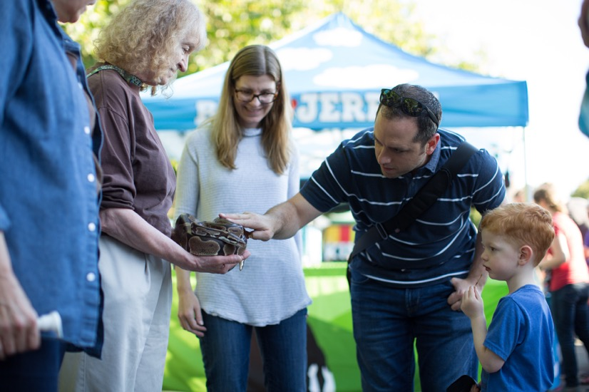
The result: Greater animal wellbeing and growth in our organization’s sustainability, reputation, and impact.

Slide 12
Experiences from the field

Slide 13
Accredited zoos and aquariums have worked for more than a decade to develop and test empathy for wildlife initiatives.

Slide 14



The ACE for Wildlife Network is vast and growing:
Partner Organizations
Members & Affiliates
Resources offered
Events hosted

Slide 15
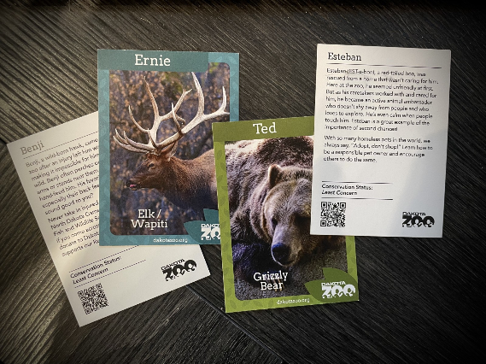
Improving Guest Experiences
Dakota Zoo piloted new educational programming that expanded guest engagement to thousands of new youth and families...
...while creating more memorable experiences and post-visit engagement via animal trading cards with conservation messaging.

Slide 16
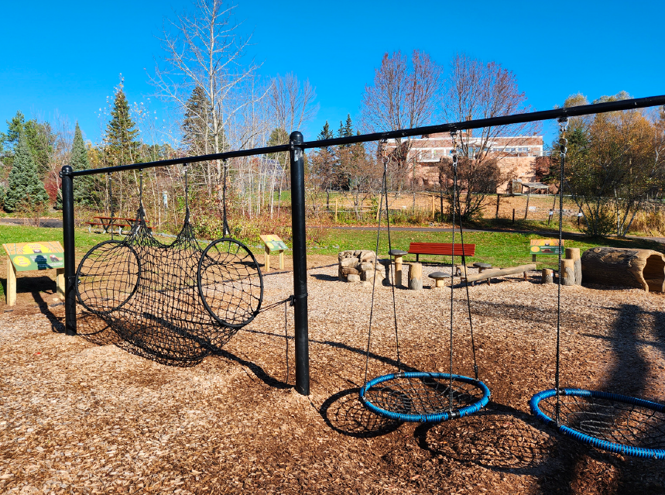
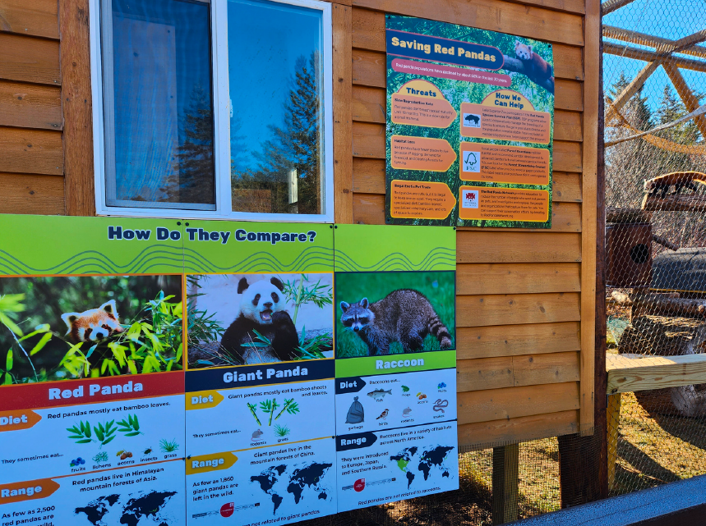
Mainstreaming Empathy Throughout Organizational Departments
Lake Superior Zoo’s cross department team (from leadership, guest experience, animal care, education, and marketing) designed a new empathy-centered play zone, including evaluation measures…
…allowing staff across the organization to gain new knowledge and skills in exhibit design and empathy-centered engagement.

Slide 17
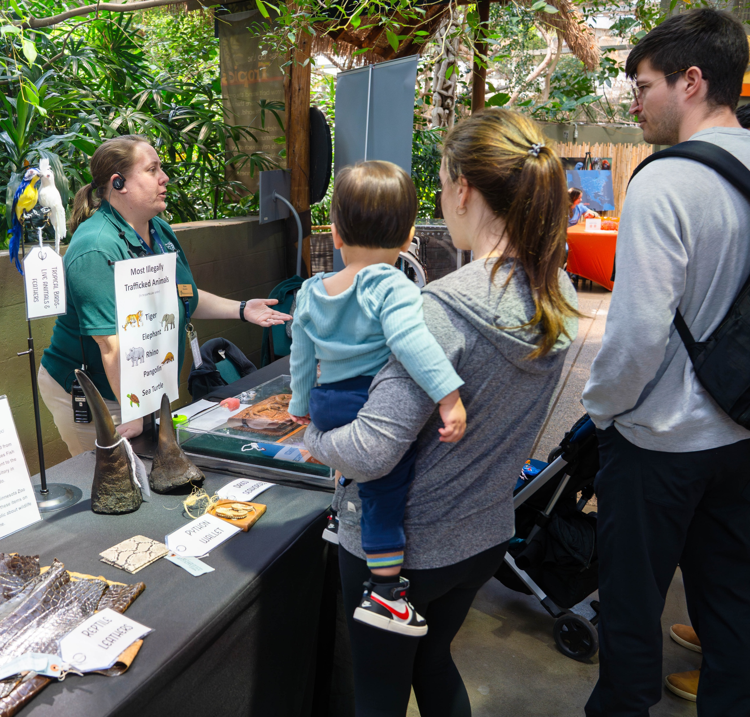
Stimulating Guests’ Conservation Actions
Minnesota Zoo paired existing animal biofacts with
real wildlife trafficking and responsible tourism scenarios…
…enabling guests to identify, practice, and improve making decisions related to conservation while learning about wildlife, making information about both animals and conservation “stickier.”

Slide 18
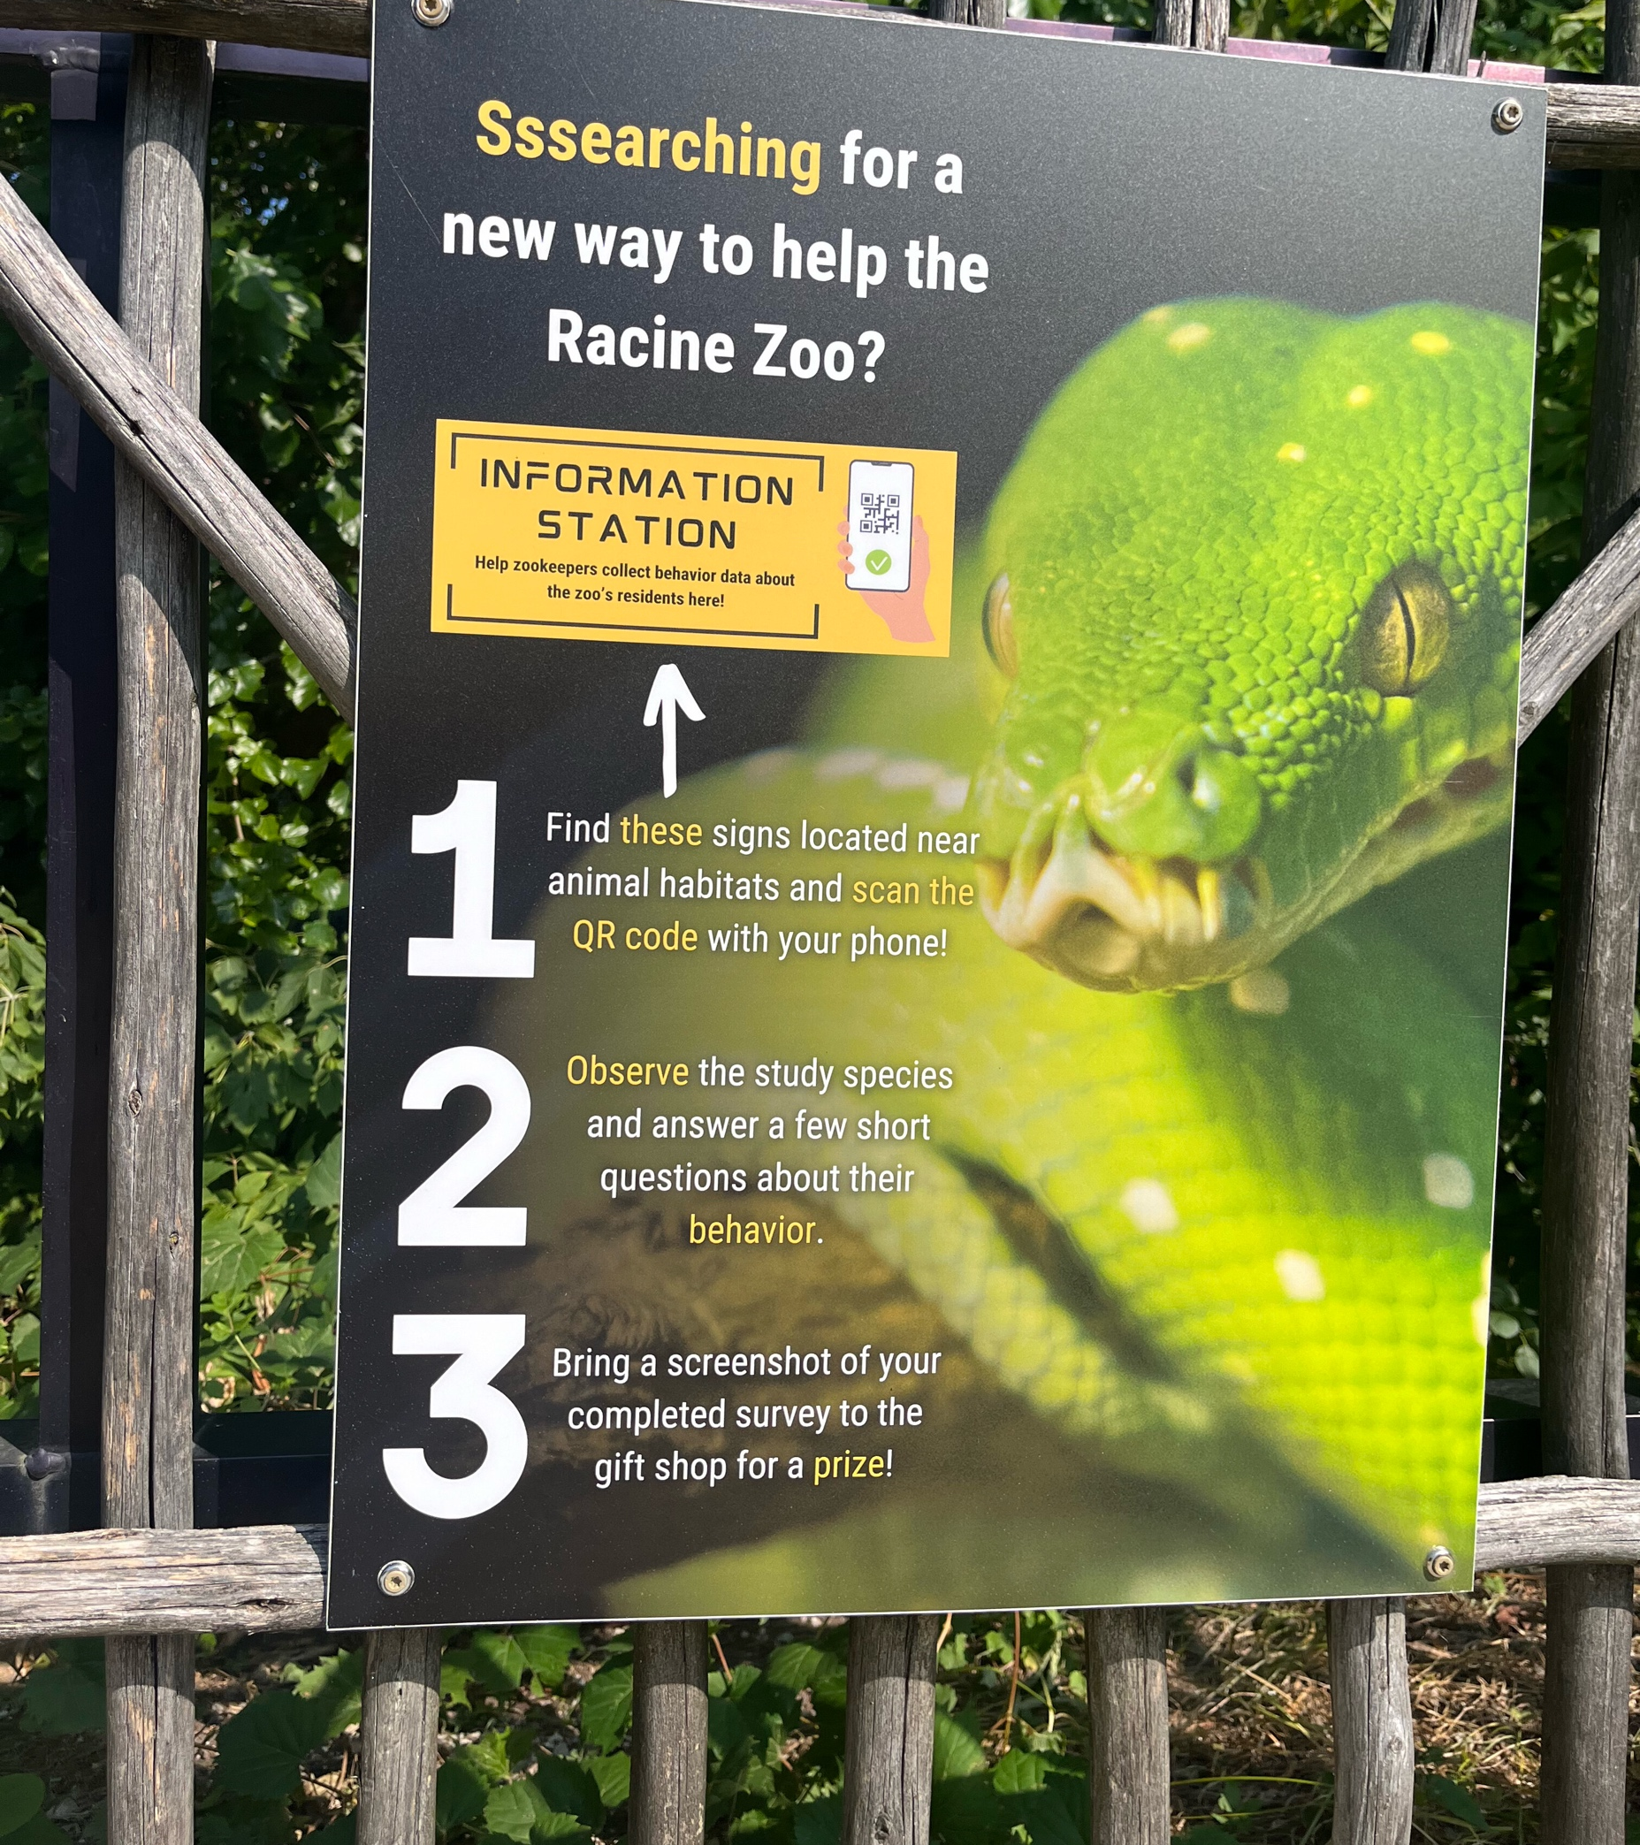
Supporting Staff Needs
Racine Zoo used habitat signage to enlist guests in making
time-based observations about individual animal behaviors…
…enabling the animal care team to extend their data-gathering capabilities without adding staff hours, and reframing guests as partners in animal care.

Slide 19
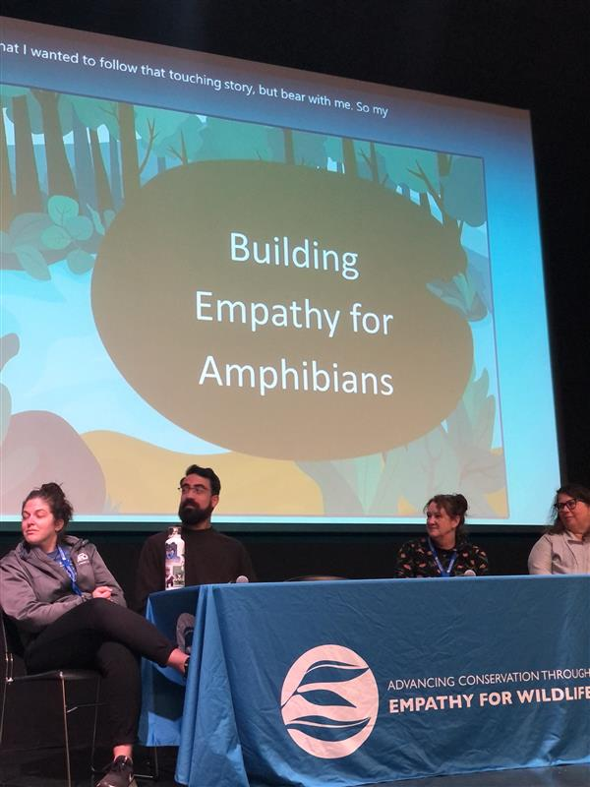
We’re influencing work throughout the zoo and aquarium field
Sparking conversation in AZA channels about how science-based critical anthropomorphism can help guests begin to empathize with animals in our care.
Convening panel discussions with peers about professionals’
real-world experiences with fostering empathy towards
“less charismatic” species – plus a literature review.
Undertaking research studies and a scholarly article about how word choice in interpretation programs can foster more constructive reactions.

Slide 20
How empathy for wildlife works for us

Slide 21
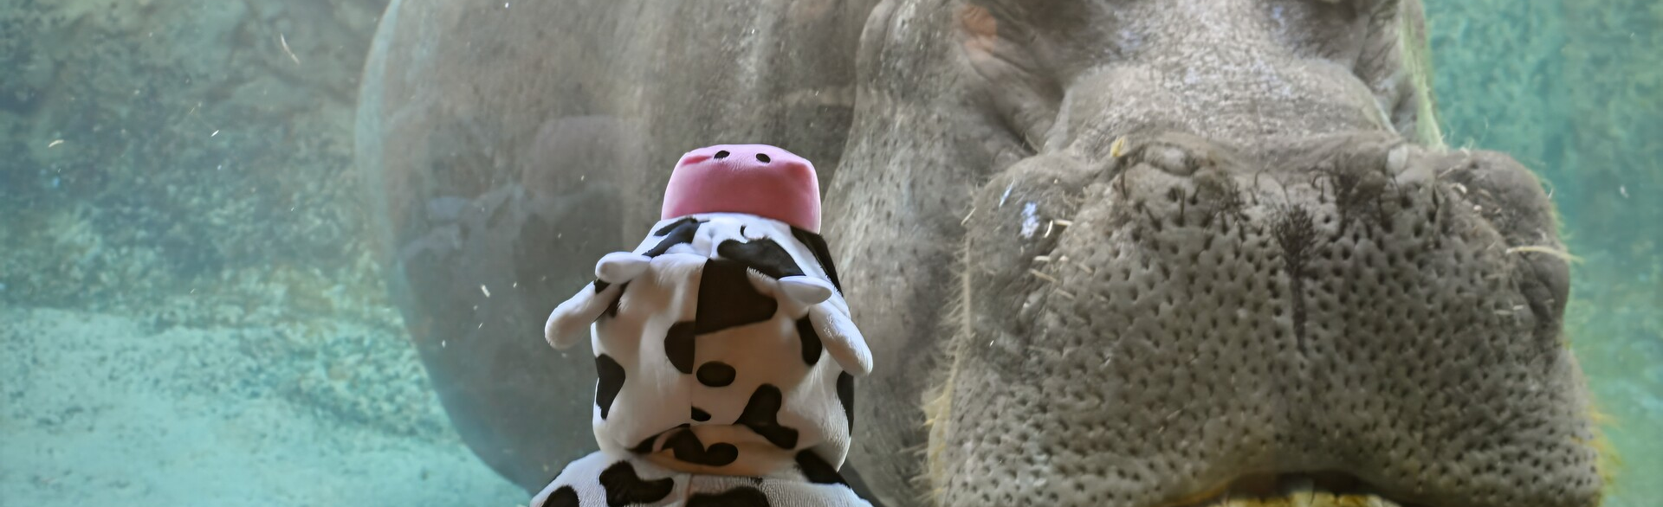
Empathy for wildlife can elevate our mission and inspire guests to join us
Motivate guests’ support for restoring habitats and ecosystems in the wild
Encourage guests to take personal action like shopping mindfully, driving carefully, keeping distance from wildlife while on vacation, and becoming responsible pet owners
Ardoin et al., 2025 and Burnet, Bernhardt, & Panciroli, 2024

Slide 22
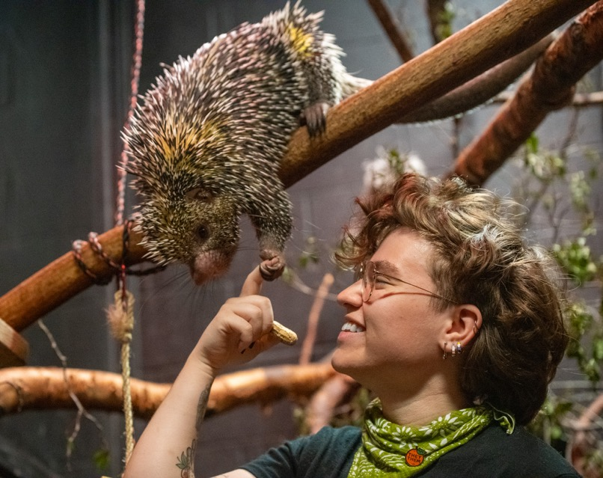
Empathy for wildlife can enhance guests’ experiences with us
Fuel positive word of mouth
Inspire feelings of connection with nature and others
Help retain and increase attendance
Improve engagement and learning
Drive donations and public support

Slide 23
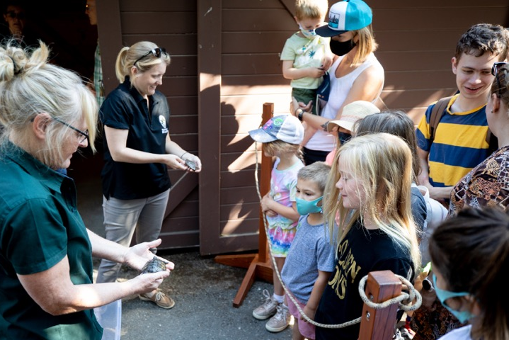
Empathy for wildlife can give staff extra support and tools
Improve staff/guest interactions
Make it easier to manage misguided questions or redirect hostile or indifferent attention
Improve guest behavior towards animals on site, increasing animal wellbeing
Enhance “stickiness” of science-based learning

Slide 24
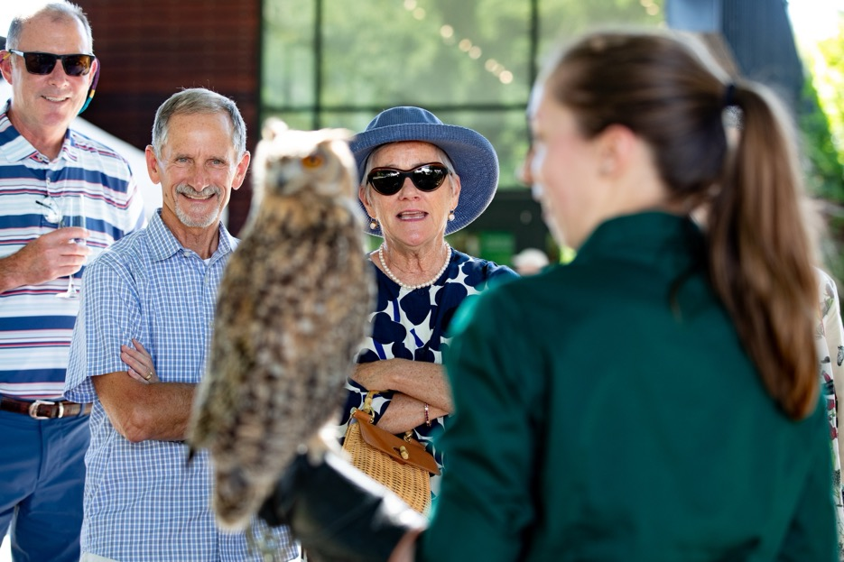
Empathy for wildlife can improve our stature in the community
Drive better understanding of our role and support for our work
Influence a ripple effect of positive social change
Cultivate society’s hope for a better future

Slide 25
Ready-to-use Network resources

Slide 26
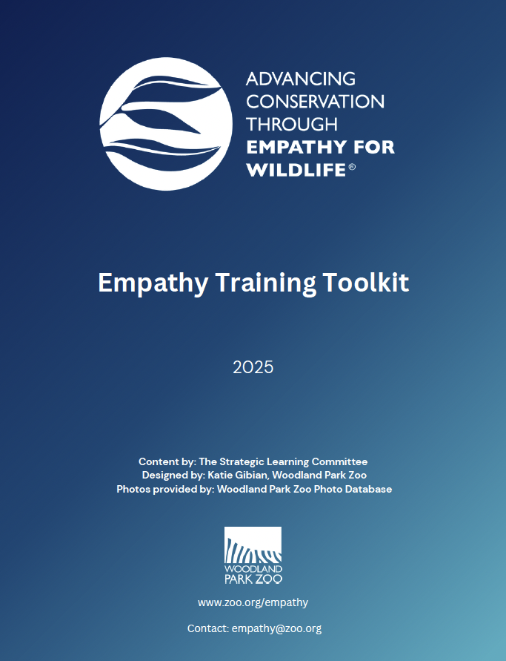
Empathy Training Toolkit
Train in-house staff on how to use empathy practices with guests, with ready-to-use resources – and new curriculum additions coming soon.

Slide 27
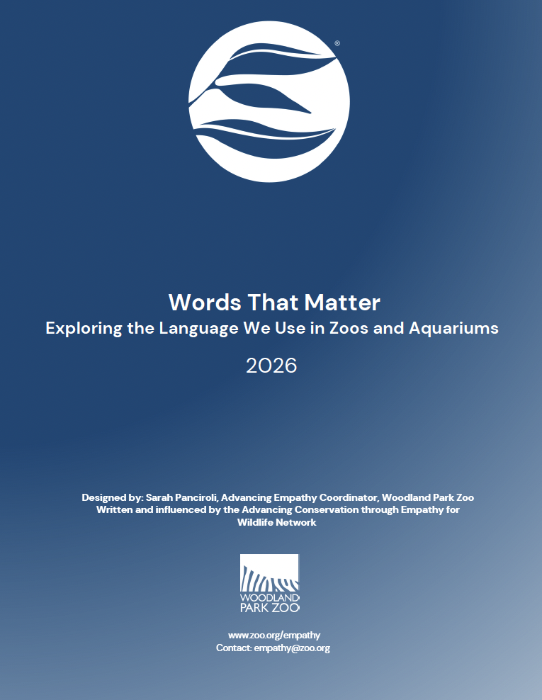
Words that Matter
Infuse interpretation, public programs, digital communications, and fundraising appeals with tested messaging that improves audience understanding and fosters connection.

Slide 28
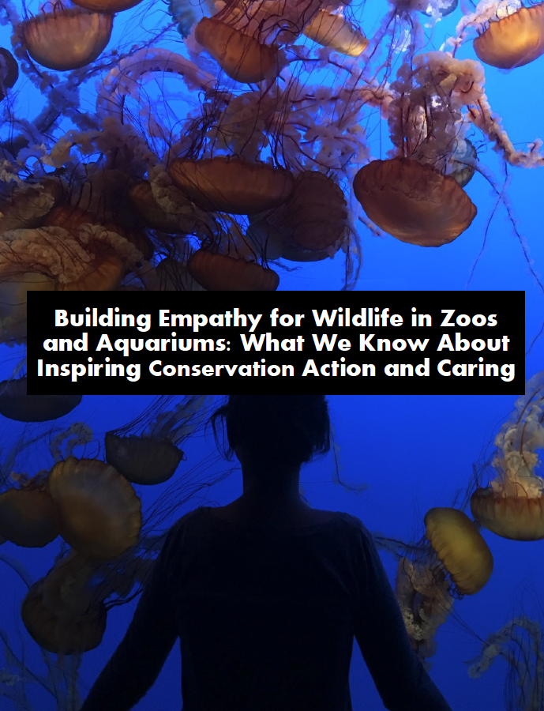
Building Empathy for Wildlife
Help staff make evidence-based decisions about empathy for wildlife initiatives and understand how empathy-infused guest engagement and conservation action are linked.

Slide 29
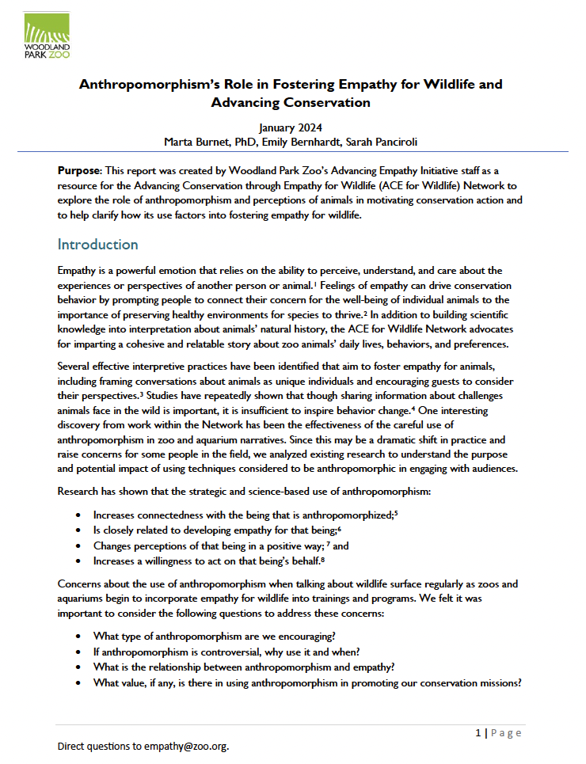
Anthropomorphism Literature Review Report
Guide decisions about when to use critical anthropomorphism as a constructive learning tool and conservation motivator.

Slide 30
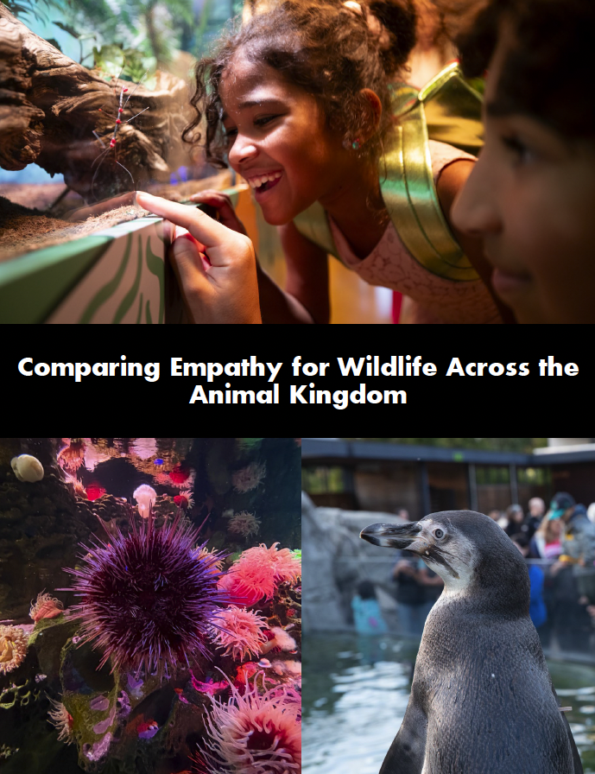
Comparing Empathy for Wildlife Across the Animal Kingdom Report
Find pragmatic strategies for implementing empathy practices across varied species, visitor demographics, and exhibit designs – particularly for use with underappreciated or stigmatized animals.

Slide 31
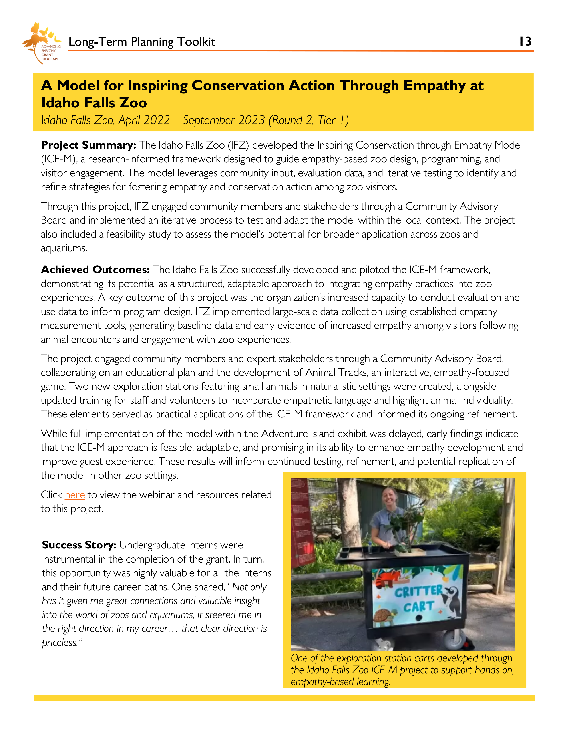
Advancing Empathy Grant Program Toolkits
Access a shared library of proven approaches spanning themes like animal ambassadors, exhibit design, and on-site interpretation, to jumpstart or improve empathy-based programming.

Slide 32
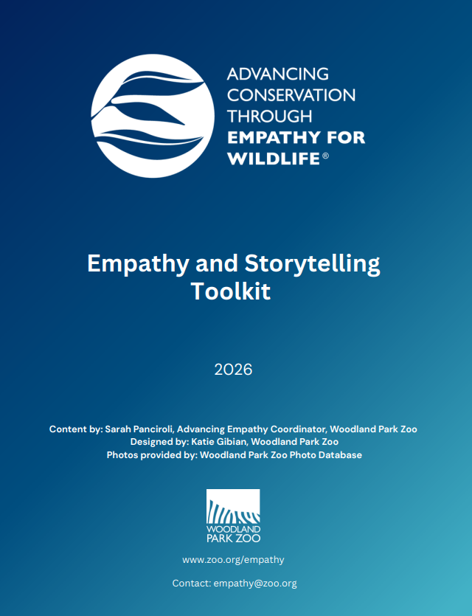
Empathy and Storytelling Toolkit
Build a shared foundation of ethical, engaging, and effective storytelling practices to help staff tell conservation stories and better understand why storytelling matters to this work.

Slide 33
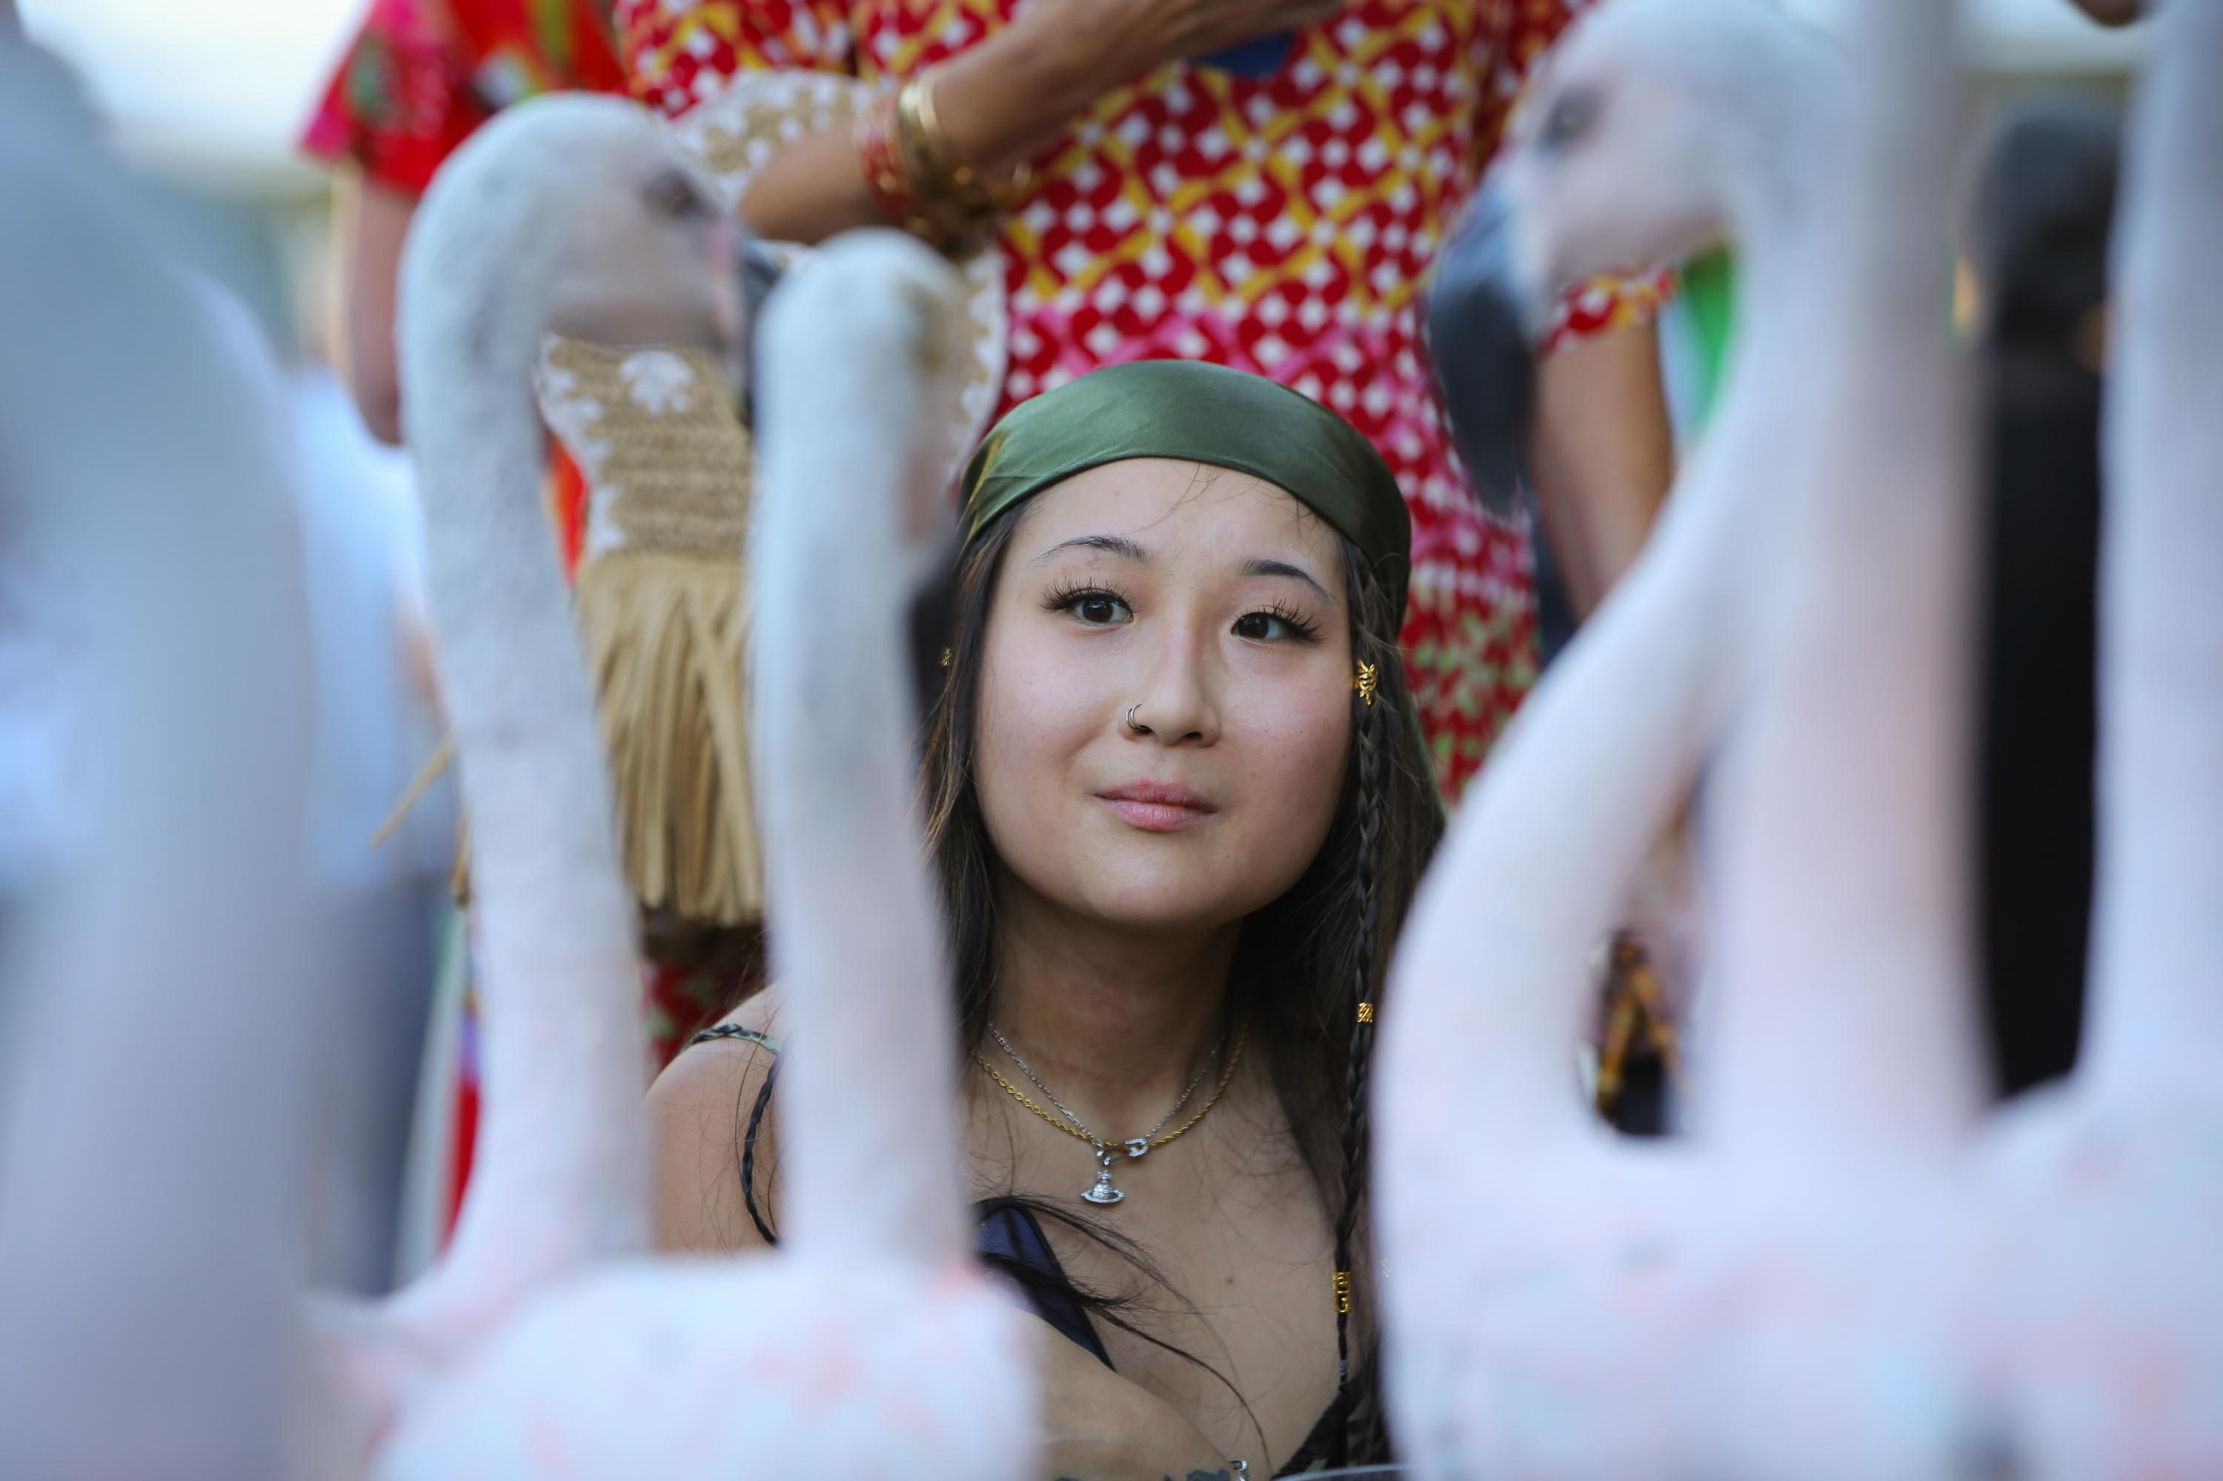
The future of zoos and aquariums depends on collaboration with guests—and with our field at large—to advance wildlife conservation goals.
Empathy is a pathway to reach that future.

Slide 34
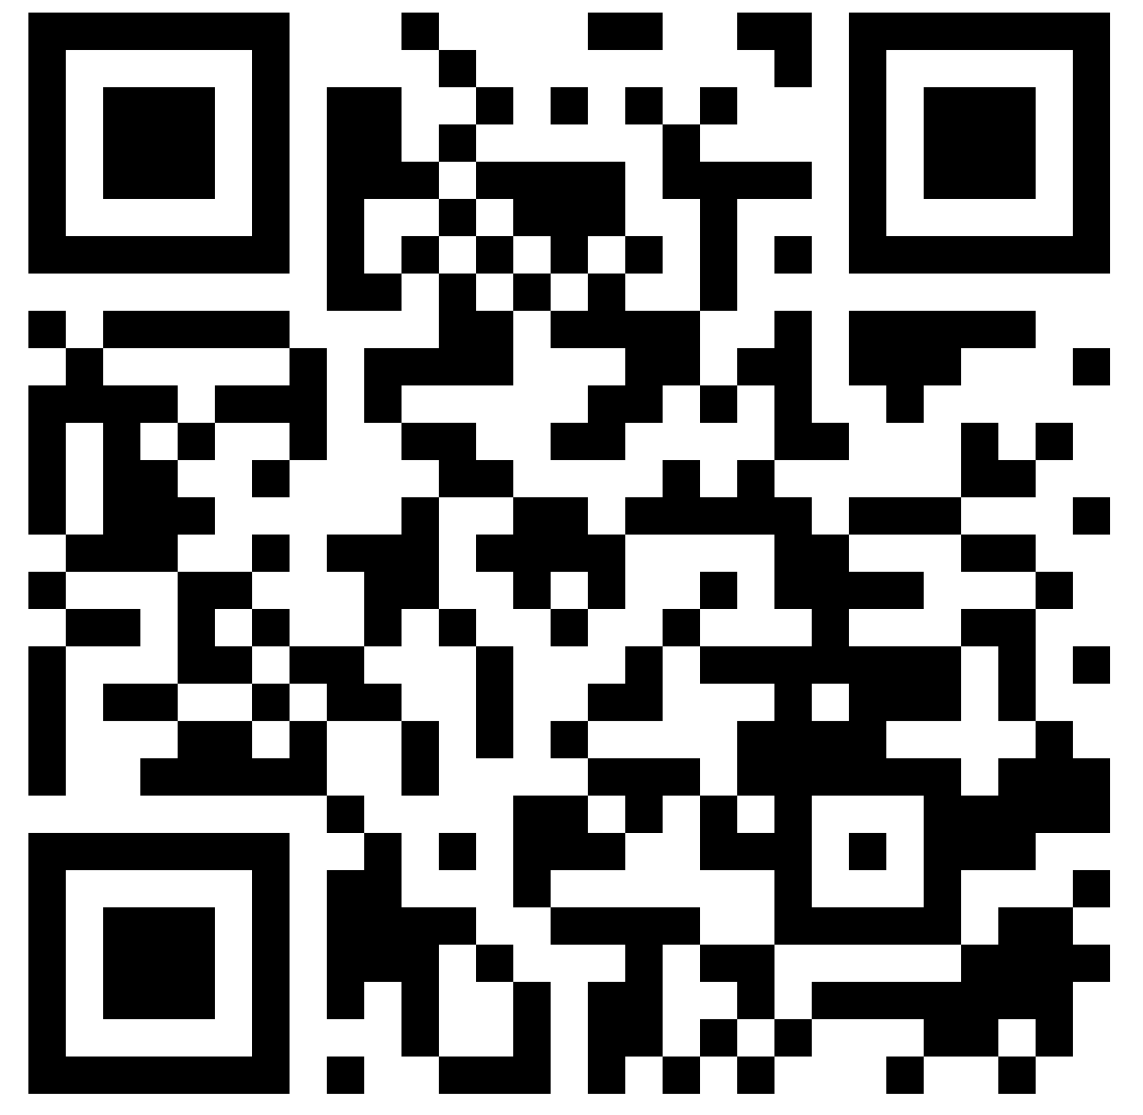
Credits and Citations
Photo Credits: Marta Burnet (slide 10, 30), Heidi Beal (slide 22), Dakota Zoo (slide 15), Joel Miller/Milwaukee County Zoo (slide 21), Lake Superior Zoo (slide 16, 22), Minnesota Zoo (17), Nicole Ardoin (slide 28), Racine Zoo (slide 18), Woodland Park Zoo (slides 6-8, 10-11, 13, 19, 21, 23-24, 30, 33), and Zoological Society of Milwaukee (slides 21, 31).
Ardoin, N.M, Bowers, A.W., Burnet, M.M., & Sherman, W. (2025). Building empathy for wildlife in zoos and aquariums: What we know about inspiring conservation action and caring. The Social Ecology Lab at Stanford University and Woodland Park Zoo.
Ardoin, N. M., Bowers, A. W., Burnet, M. M., & Sherman, W. (2025). Comparing empathy for wildlife across the animal kingdom. The Social Ecology Lab at Stanford University and Woodland Park Zoo.
Burnet, M., Bernhardt, E. & Panciroli, S. (2024). Anthropomorphism’s role in fostering empathy for wildlife and advancing conservation. ACE for Wildlife Network and Woodland Park Zoo.
Whitley, C. T., Barrailler, K., Jackson, M., Bamberger, T., & Burnet, M. (2026). Empathy toward animals: Documenting measurement instruments used in research and practice. Journal of Zoological and Botanical Gardens, 7(2), 22. https://doi.org/10.3390/jzbg7020022.
Find Network resources here

